Slide 1
REC 2017: IT Service Monitor
By: Jonathon Wells, Quinn Bast, Shawn Clake, Jennifer Herasymuik

Slide 2
Problem Statement
In today’s fast moving society, downtime or delays of even a few hours can cost a company millions of dollars. We are being contracted to provide a way to monitor a company’s applications and services.
We are to design a multi-platform monitoring application that can monitor the health of any number of services. It should keep track of the services and alert the appropriate IT staff automatically upon a negative turn in a services health.

Slide 3
Technologies Used
HTML, CSS, Javascript
Bootstrap
MySQL
Server
PHP

Slide 4
Solution Design
Services that are being monitored by our application are pinged every minute. The return ping indicates the health of the service, with no reply being a sick or down service. At this point, the service healths are updated on a dashboard, where the issue can then be marked resolved by an IT administrator.

Slide 5
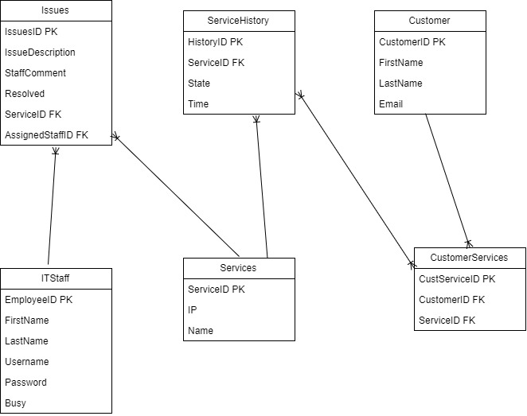
Database Implementation
Issues
Customer
ITStaff
Services
Issues
CustomerServices

Slide 6
Dashboard Page
The dashboard serves as the application’s homepage. It displays the list of all services that are being monitored with their health and IP address, as well as an option to view their details or resolve the issue if it is sick.

Slide 7
Details Page
The details page for each service displays the history of issues, as well as a link to the 50 most recent pings and whether or not they worked. It also displays the IT employee that was automatically assigned to the issue.

